Slide 2
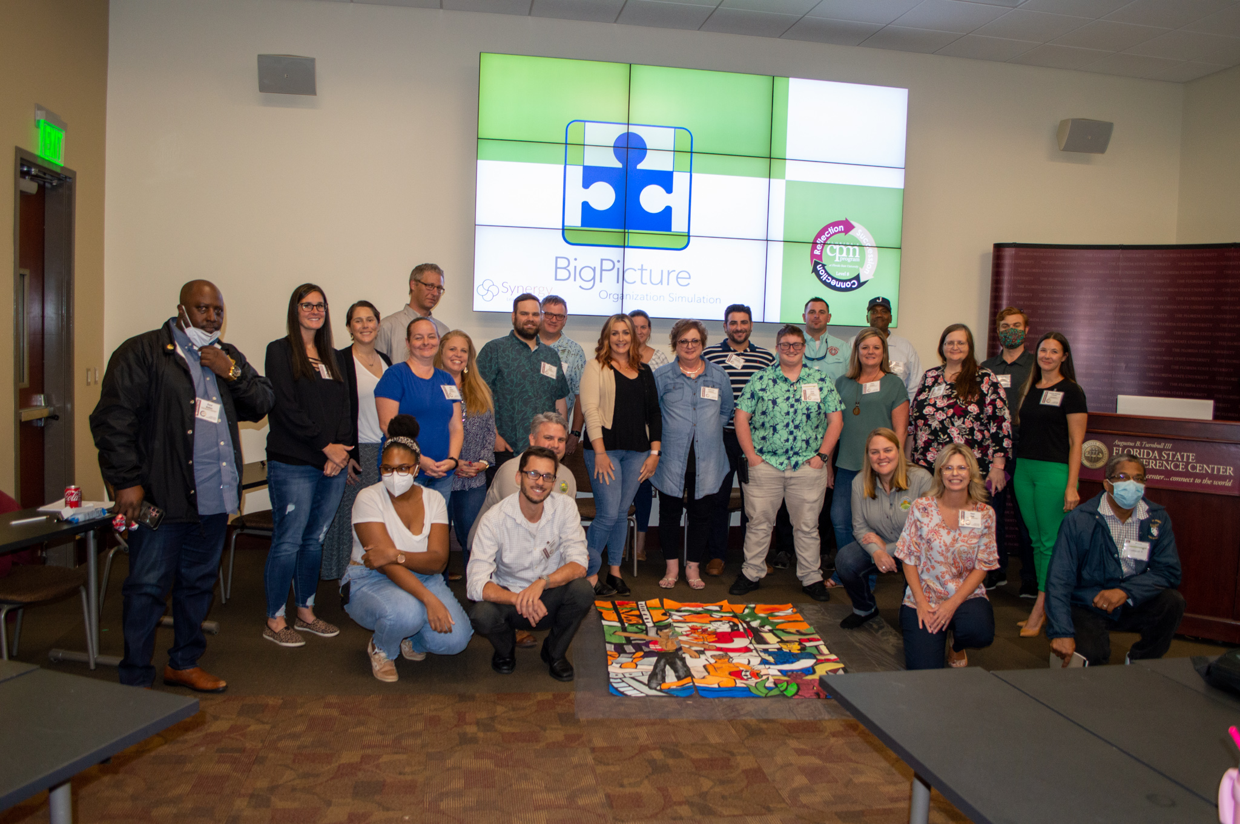
What is CPM?
A nationally recognized, comprehensive training and development program for public sector managers.

Slide 3

A National Program
Forty-two states currently accredited
Program created to fill a vacuum in public management training
Modeled on national CPA certification programs

Slide 4


CPM in Florida and the U.S.
When you have completed one CPM level, you are eligible for membership in the Florida Society of Certified Public Managers.
The Florida Society of Certified Public Managers has active chapters around the state that offer ongoing workshops and professional development opportunities.

Slide 5
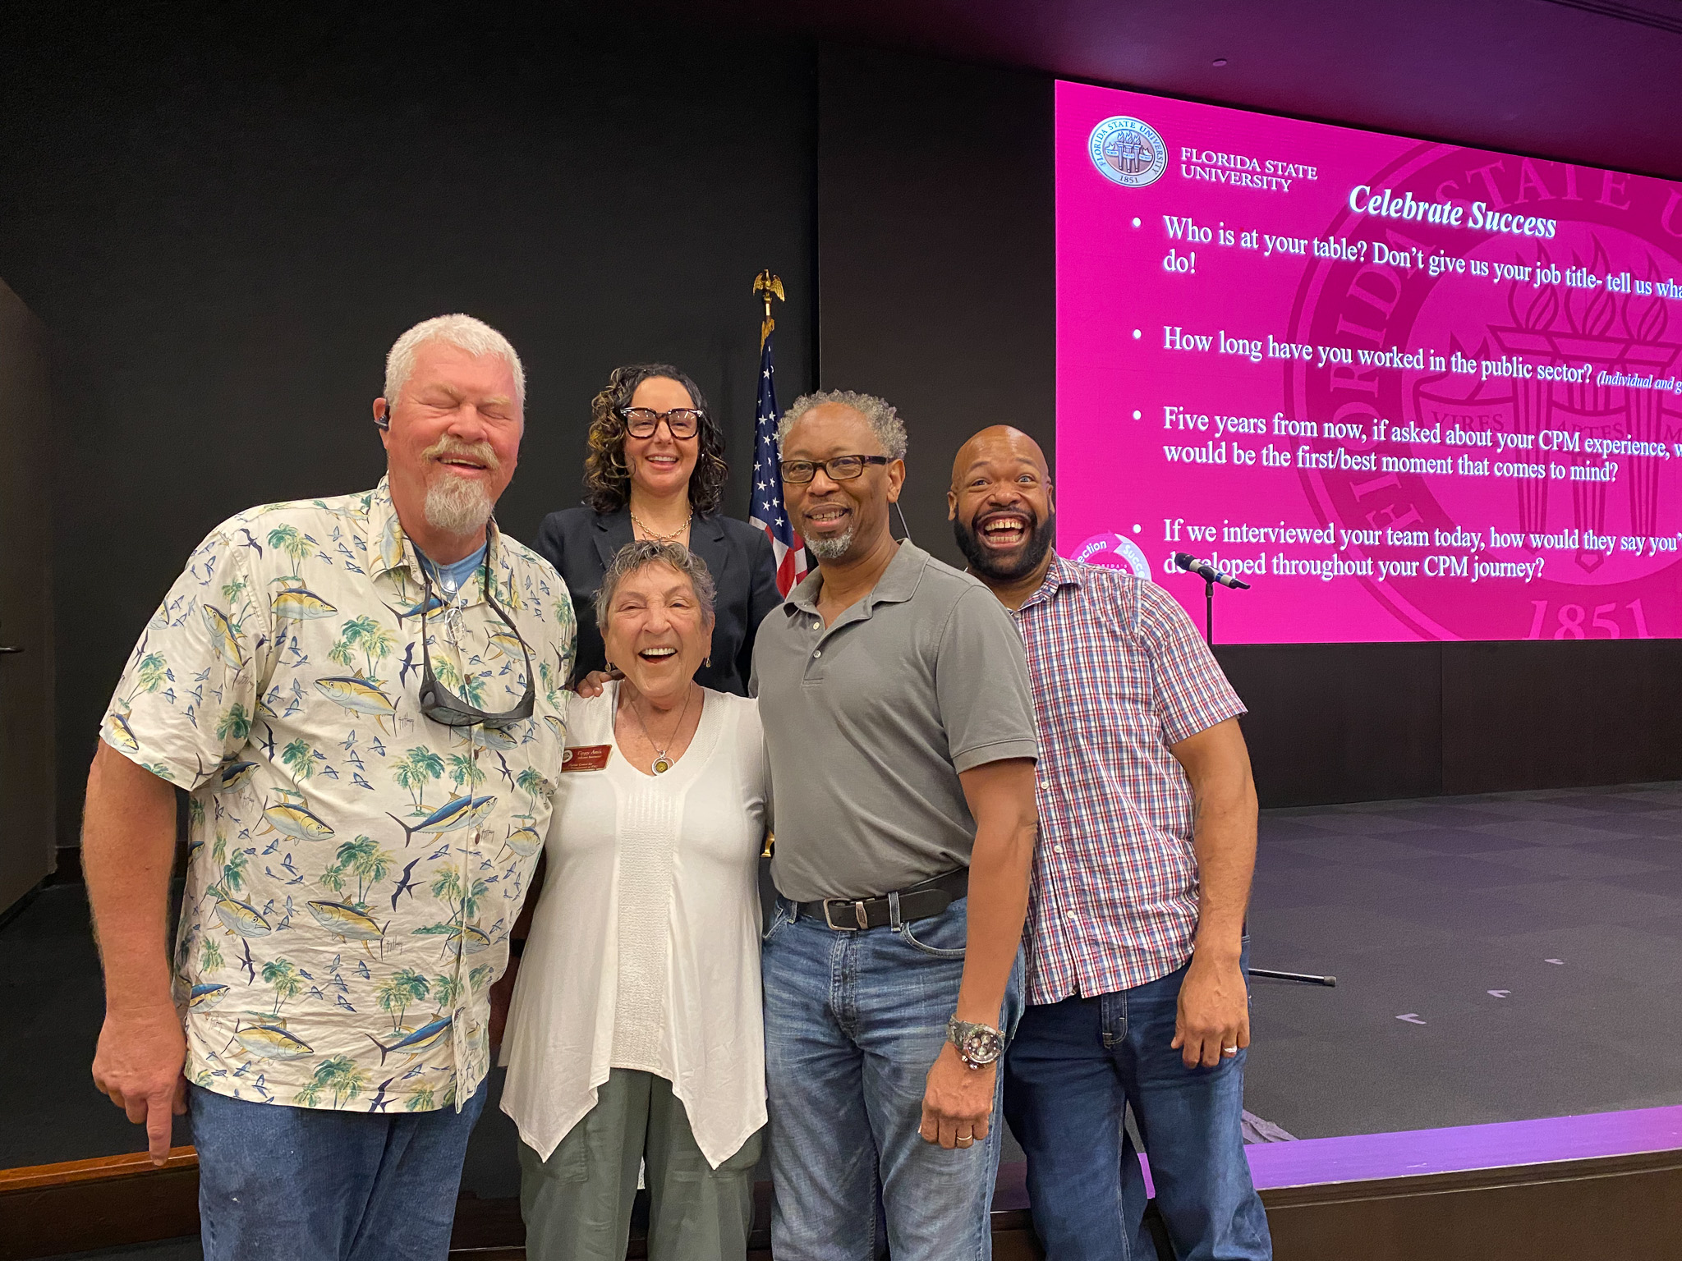
Florida’s CPM Success Story
Founded in 1979 at Florida State University
FCPM administers and delivers the largest program in the U.S.
Over 8500 graduates statewide as of August 2023

Slide 6
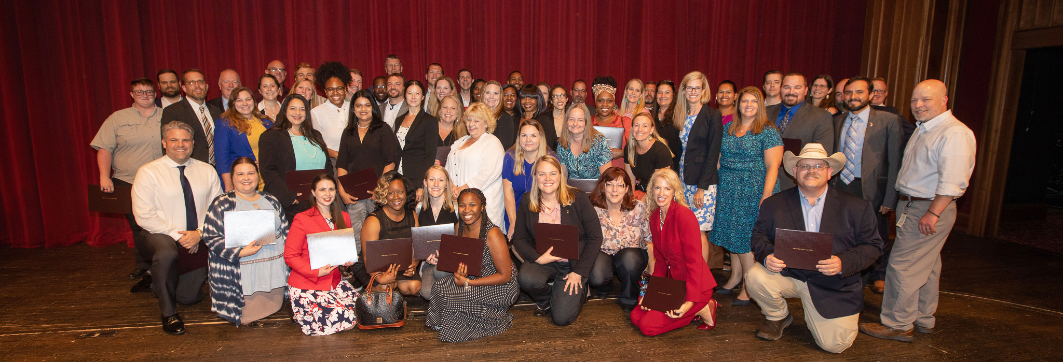
Who Participates in CPM?
State Agencies • Constitutional Officers • County Governments
City Governments • Miscellaneous others

Slide 7
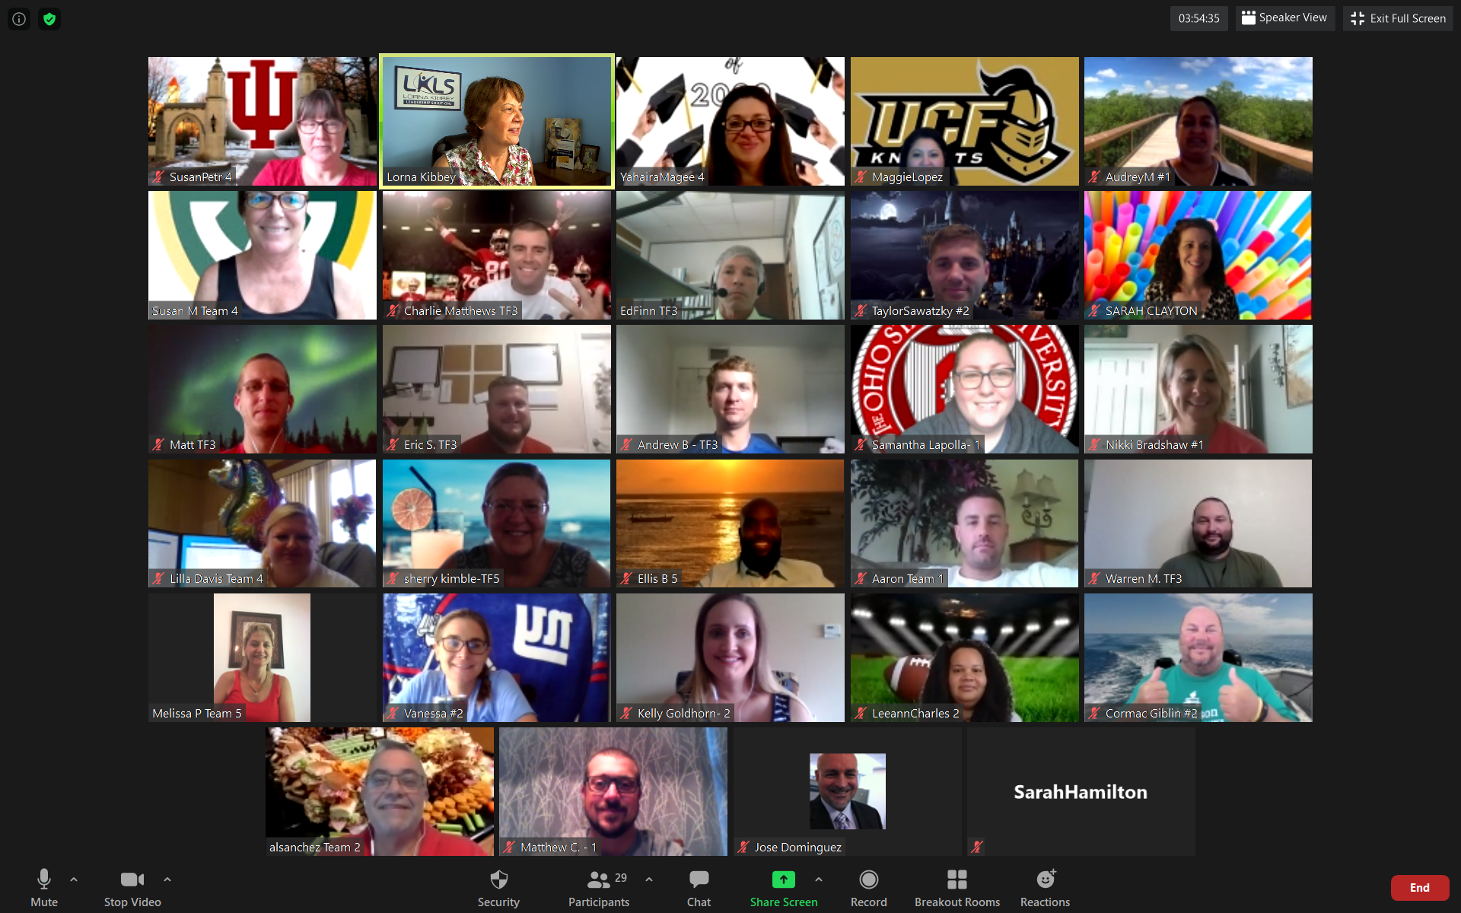
Our Goal
To develop reflective practitioners that are contemporary leaders

Slide 8
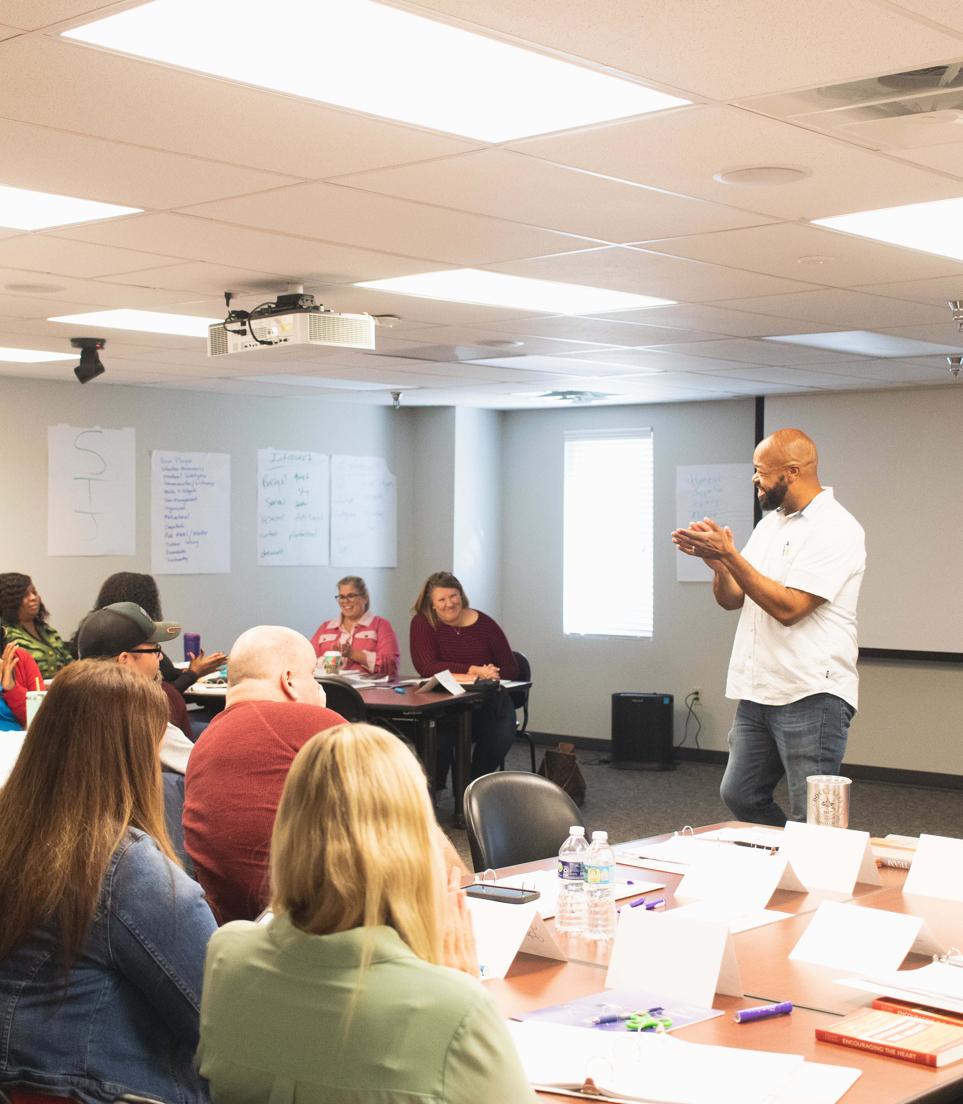
Program Structure
Eight levels total
Levels 1-7, 4 full days
Level 8, 3 full days, convention style
Experientially based
Emphasis on group activities
Balance of theory and practice

Slide 9
CPM Curriculum – The Inverted Pyramid
CPM Curriculum – The Inverted Pyramid
8 - Graduation
7 – Public Policy
6 – Systems Thinking
5 – Social Change
4 – Ethics & Power
3 – Org. Issues
2 - Teams
1 - Self

Slide 10

Level One
Focuses on self-awareness and management one-on-one
Topics:
Transformational Leadership
Personal Style
Delegation
Motivation
Goal setting
Performance Feedback
Coaching & Counseling

Slide 11

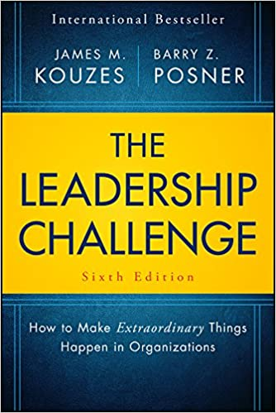
Required Reading for Level 1
Alternate

Slide 12

Level TWO
Expands the focus to groups and teams
Topics:
Group dynamics
Conflict
Team leadership
False consensus
Problem solving
Decision making
Process improvement

Slide 13
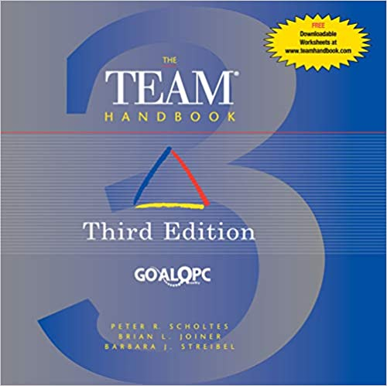
Required Reading for Level 2

Slide 14

Level three
Emphasizes organizational issues
Topics:
Productivity & Quality
Organizational Communication
Information Technology
Emotional Intelligence
The Sterling Process
Project Management

Slide 15

Level four
Big picture organizational issues
Topics:
Power
Ethics
Organizational Culture
Organizational Change

Slide 16

Level five
Examines how government must adapt to the future
Topics:
Social change and its impact on public management
Generations at work
Changing values in America
Strategic planning and budgeting
Organizational designs for the future
Organizational dynamics

Slide 17

Level six
Teaches the systems approach to management
Topics:
Systems thinking
Real world applications of systems thinking

Slide 18
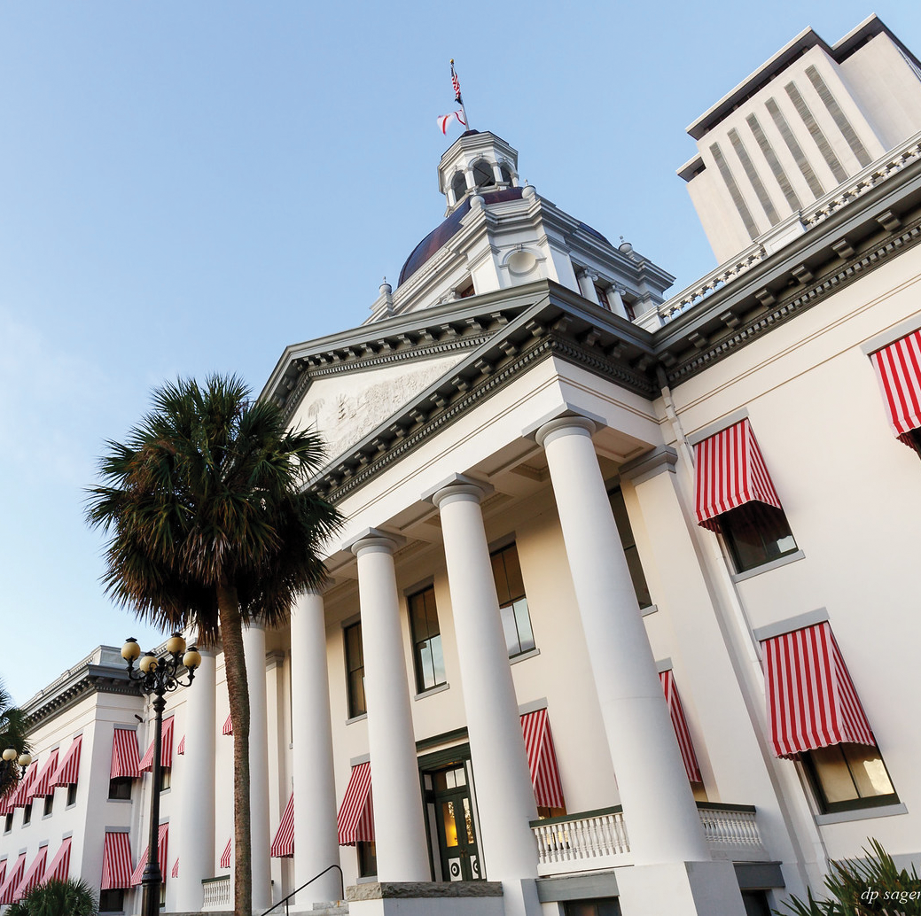
Level seven
An in-depth seminar on public policy
Topics:
Policy Development
Policy Argument & Critique
Policy Models
Making Policy Presentations

Slide 19

CPM graduation week
Contemporary Issues
Organized around break-out sessions, presenters discuss the latest issues in public management and the application of CPM principles in real life.
The final day is the
graduation ceremony

Slide 20
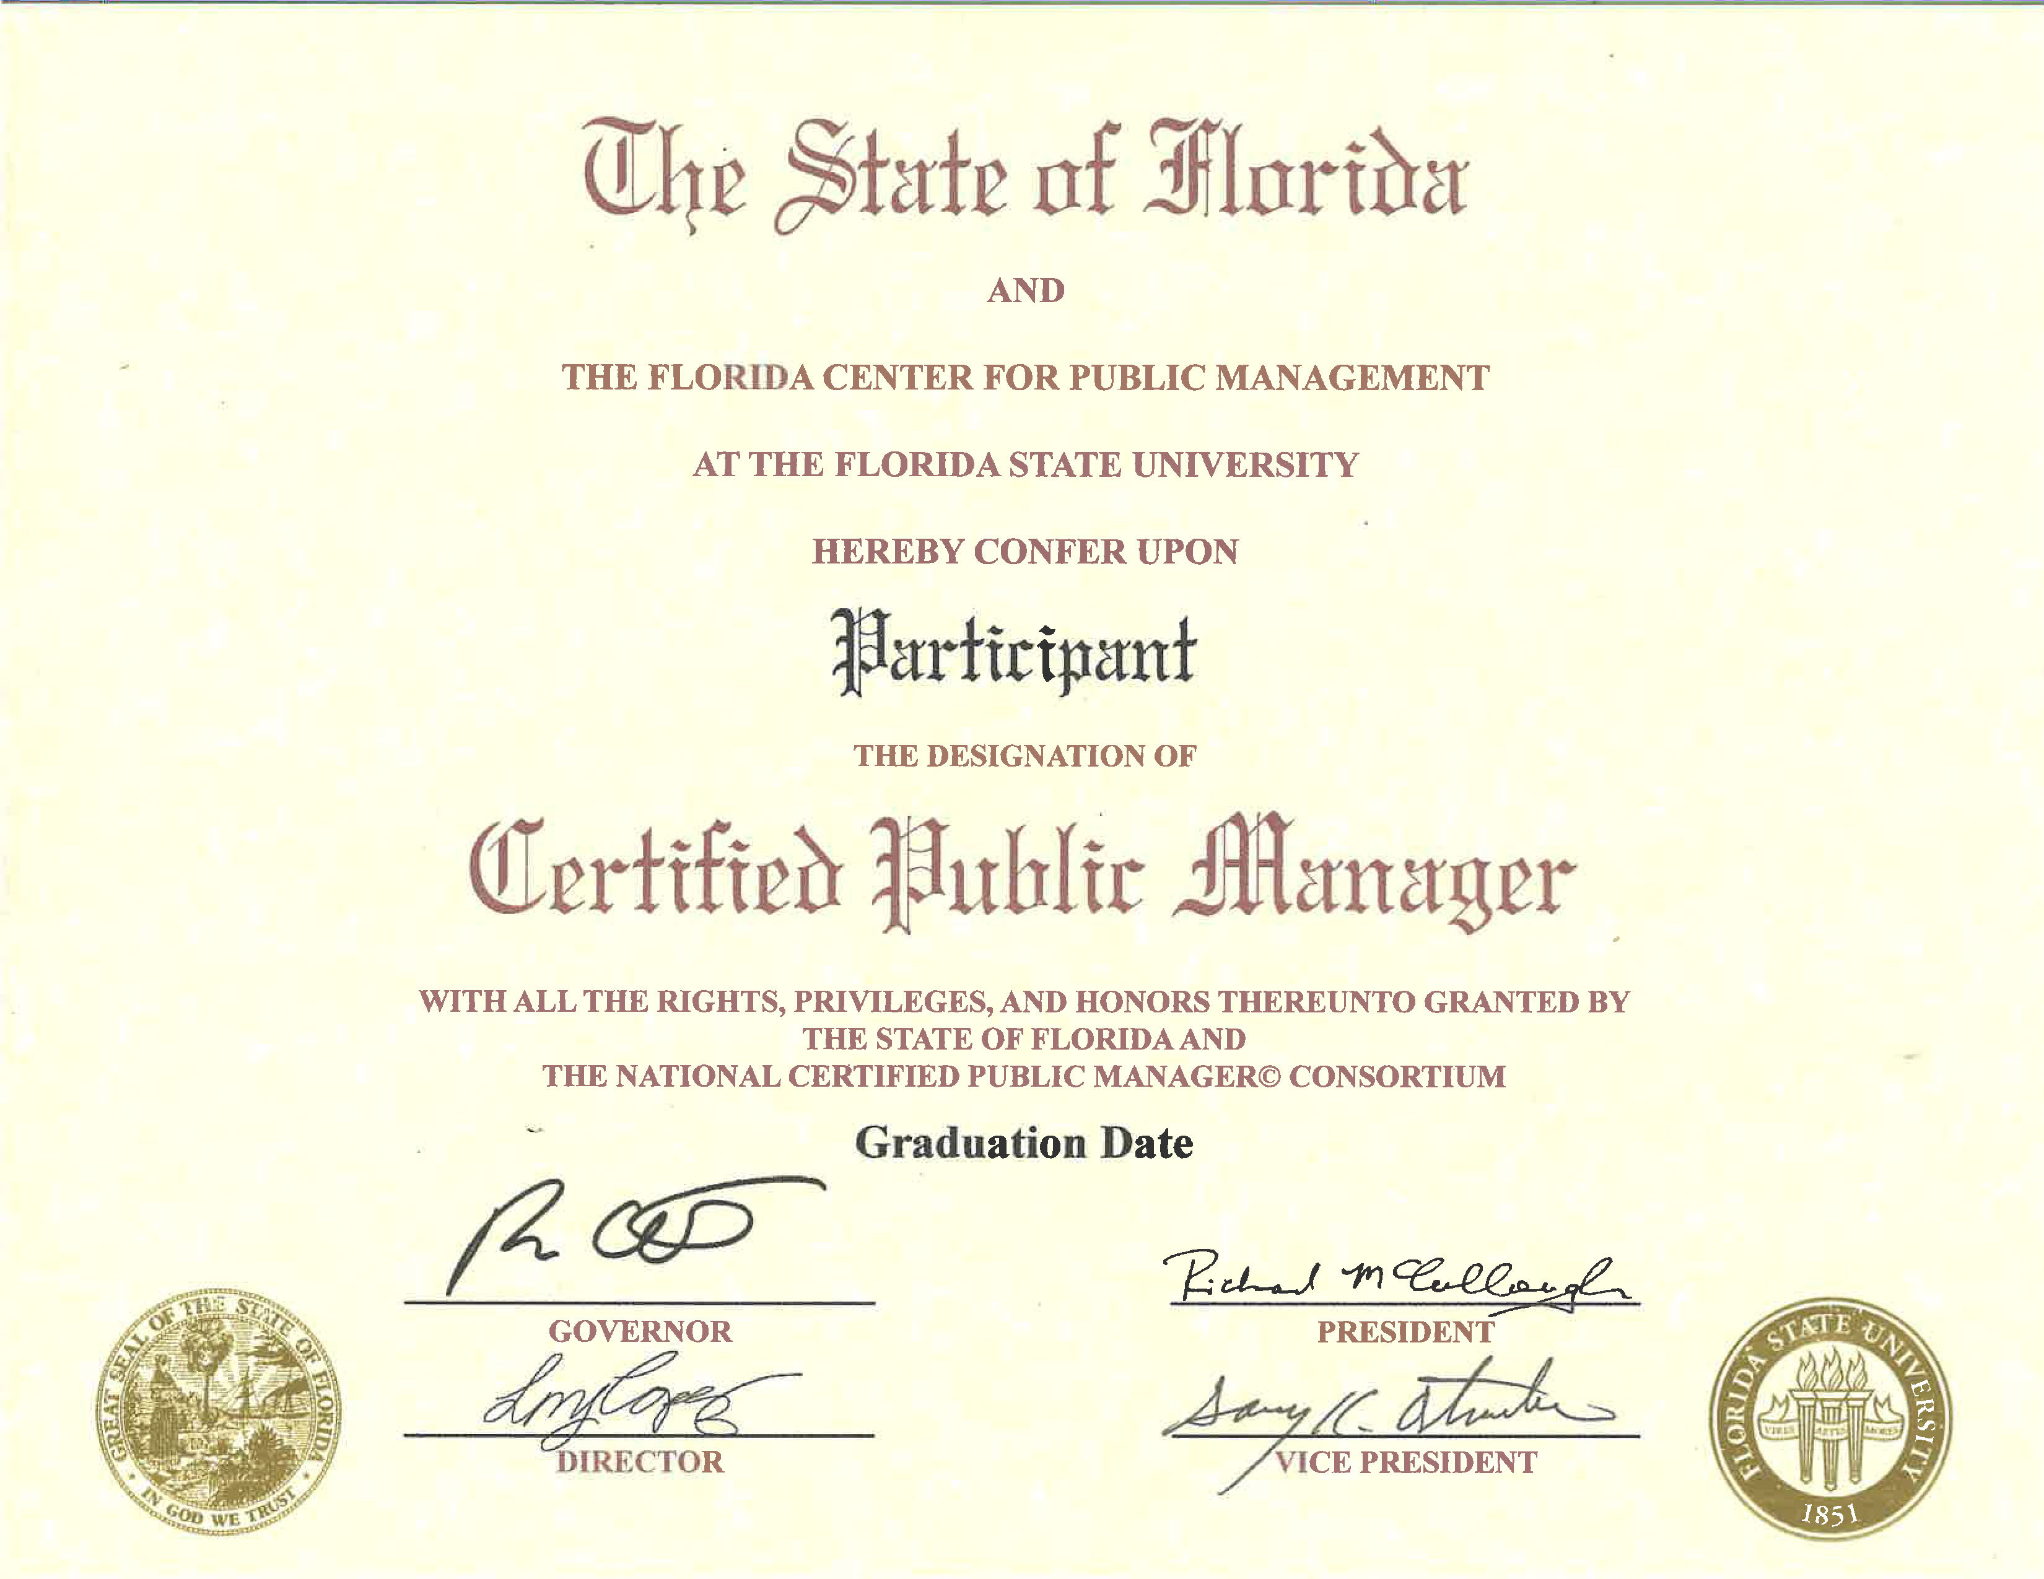

Slide 21
Certified Public Manager
National Consortium requires 300 contact hours to become a CPM
Exams are take-home, open-book
Some homework assignments are done on your own, some in groups, and some in class
FCPM does not assign deadlines for completing homework, however your organization might
It’s up to YOU to get it done!

Slide 22
Certified Supervisory Manager Designation
Level 1 | Management of Individual Performance
Level 1 Assignment | Kouzes and Posner, Encouraging the Heart | Individual
Level 1 Exam | Select one question and answer | Individual
Level 2 | Management Of Group Performance
Level 2 Assignment | Scholtes, The Team Handbook, Third Edition | Group
Level 2 Exam | Select one question and answer | Individual
Level 3 | Management Of Organizational Performance
Level 3 Assignment | “Is Productivity More Than a Slogan In Your Organization?” | In Class
Level 3 Exam | Select one question and answer | Individual
Level 4 | Managing Organizational Effectiveness
Level 4 Exam | Select one question and answer | Individual

Slide 23
Certified Public Manager Designation
Level 5 | Social Change & Its Impact On Public Management
Level 5 Assignment | A Performance Improvement Application | Group or Individual
Level 5 Exam | Select one question and answer | Group or Individual
Level 6 | A Systems Focus
Level 6 Assignment | Improving Systems | Group or Individual
Level 7 | Policy Perspectives
Level 7 Assignment | Shaping Your Executive Growth | Individual
Level 7 Exam | Select one question and answer | In Class
Level 8 | Contemporary Issues In Management-- Graduation

Slide 24
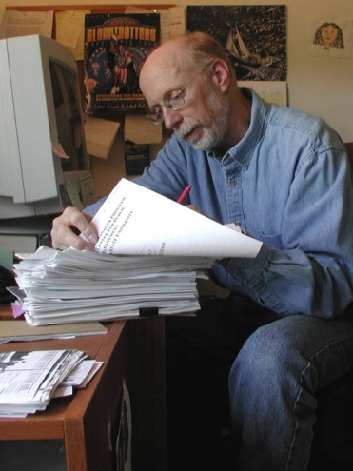
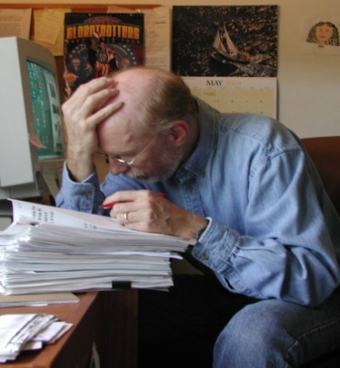
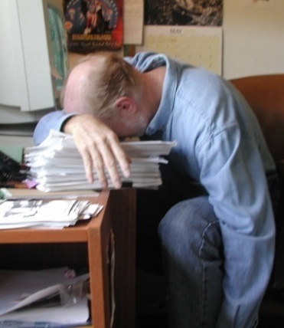
Homework Assignments are Pass/Fail
Assignments & exams are uploaded to our website
Assignments & exams are graded within 60 days, usually sooner
Scenario #1: you get an email saying “Assignment completed”
Scenario #2: you get an email telling you how to correct it for resubmission

Slide 25
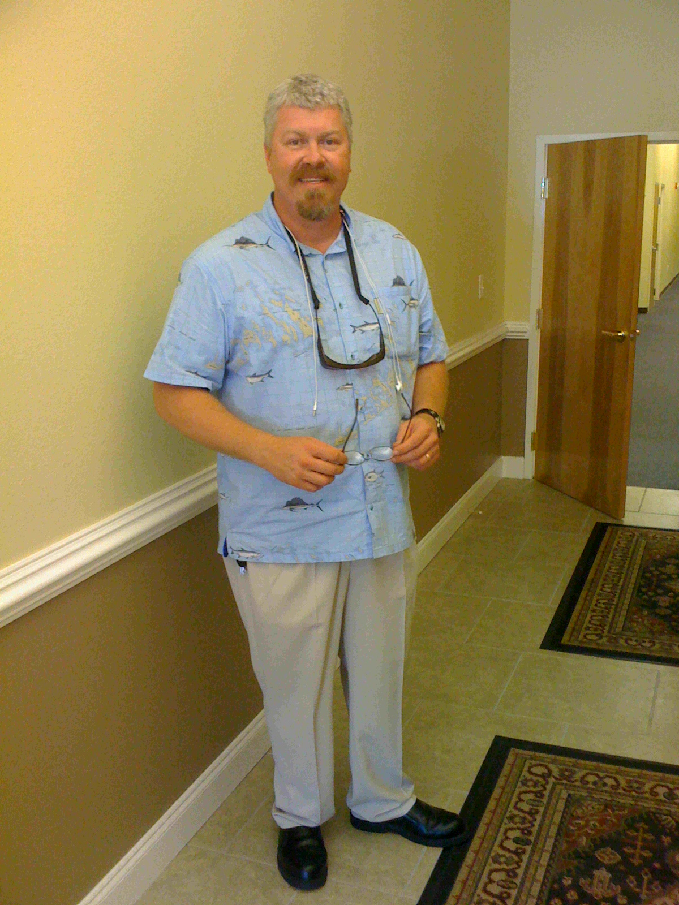
FCPM Student Liason
Daniel R. Vicker, Ph.D. - dvicker@admin.fsu.edu
Assignment/exam inquiries or questions
Issues submitting your papers to the database
Grading questions

Slide 26
Training Resources
Your CPM Binder/Notebook
Videos from class
Activity booklets/instruments
CPM Website - www.fcpm.fsu.edu
Your Instructor

Slide 27
Attendance Procedures
The National CPM Consortium requires participants to put in 300 contact hours
Taking classes in order is preferred, however exceptions can be made on an individual basis
Participants may miss one half day in a four day session without a makeup
If a full day is missed, it must be made up in a later class
Attendees may make up a class with another agency
Keep your instructor informed of your attendance during each level

Slide 28

Digital Micro-Credential
Micro-credentials or badges are digital versions of a printed credential
The CPM badge can be shared in emails, resumes, ePortfolios, or on social media platforms such as LinkedIn
This digital credential is encrypted with the graduate’s information
These innovative micro-credentials are highly-valued for networking
Employers, recruiters, or colleagues can click on the badge to learn more
The CPM badge is provided to graduates following Level 8

Slide 29
Questions?
FCPM - Director
Linda Jimenez-Lopez - (813) 317-3173 - ljimenez@fsu.edu
FCPM Program Coordinator – Class Scheduling Katrinia Patrick – (850) 644-6460 – k.Patrick@fsu.edu
FCPM Accountant - Billing
Heather Eddins– (850) 644-0160 – heddins@fsu.edu
FCPM Production Assistant - Notebooks
Regina Debon – (850) 644-4968 – rdebon@fsu.edu
FCPM Faculty
Lynn Chisholm - lynn.chisholm@fsu.edu - Badging Daniel R. Vicker, Ph.D. - dvicker@admin.fsu.edu - Student Liasion
Chiquita Camacho - cpcamacho@fsu.edu - Instructor

Slide 30
Florida Center for Public management
The Florida State University
City Centre Building
227 N. Bronough Street, Suite 4600
Tallahassee, FL 32301
(850) 644-6460
www.fcpm.fsu.edu

